Slide 1

Governing Board Overview

Slide 2
Academy Software Foundation Overview and Governance

Slide 3


An Open Source Foundation Developed in Partnership
The Academy Software Foundation provides a neutral forum for open source software developers in the motion picture and broader media industries to share resources and collaborate on technologies for image creation, visual effects, animation and sound.
Notes:
The Academy Software Foundation was developed in a partnership between the Academy of Motion Picture Arts and Sciences and the Linux Foundation, both partners bringing a unique blend of film industry knowledge and open source technical and organizational expertise to create a unique organization dedicated to accelerate software development and innovation in the motion picture industry.

Slide 4



ASWF created
Open Source
Forum 2022
Open Source Days 2024
Open Source Days 2025
Open Source Days 2026
01
Open
Source
Days
2021
01
First project
Open Source
Day 2019
March 10,2022
Raw2ACES
Rez
DPEL
August 10, 2018
Founding members:
Animal Logic
Autodesk
Blue Sky Studios
Cisco
DNEG
DreamWorks Animation
Epic Games
Foundry
Google Cloud
Intel
SideFX
The Walt Disney Studios
Weta Digital
Open Source Days 2020
Open Source Days 2023
July 23-29 2024
Samsung
Caligra
August 4-10
ACES
DNA
RMTC
LAIKA
Skydance Animation
July 19-20, 2026
MoonRay
CIQ
Evercast
RIT
Open Source
Days 2022
October 23,2018
OpenVDB
New members:
Sony Pictures Entertainment
Warner Bros.
Blender Foundation
Visual Effects Society
July 29, 2019
OpenTimelineIO
Netflix
Amazon Web Services
Rodeo FX
MovieLabs
Aug 19-20 2020
Unity
Conductor Technologies
SMPTE
Aug 4-5
2021
MaterialX
Maxon
Open
Source
Forum
2025
Open Source
Forum 2026
August 8-9
OpenFX
OpenAssetIO
Open Review
Initiative
Canonical
Khronos Group
July 25 -
August 7, 2023
OpenImageIO
Otoy
Bolt Graphics
Coreweave
11
16
Feb 26 2026
OpenPGL
OpenQMC
Miris
Texas A&M
O3DE
Feb 13
OpenAPV
Stability.ai
RaynaultVFX
20
Apr 16
2020
Open
Shading
Language
AMD
DockYard
10
Sept 13
2019
Apple
Microsoft
08
Dec. 15
2020
Adobe
ETC
18
05
Open Source
Forum 2024
Open Source
Forum 2023
14
17
02
Feb 8, 2019
OpenColorIO
12
Feb 22 2024
Mod Tech
Labs
19
09
Feb 16 2023
HP
Framestore
03
May 1 2019
06
OpenEXR
OpenCue
NVIDIA
ftrack
Red Hat
07
15
13
Scitech
Council
Open source
Investigation
concludes
04
August
Oct
Feb
May
August
Sept
Feb
August
Jan
August
Feb
August
Feb
August
Feb
August
Feb
August
Feb
August
2018
2019
2020
2021
2022
2023
2024
2025
2026

Slide 5



Membership
Premier
General
Associate
Notes:
Source: https://landscape.aswf.io/embed/embed.html?base-path=&key=aswf-member-company&headers=true&category-header=false&category-in-subcategory=false&title-uppercase=false&title-alignment=left&title-font-family=sans-serif&title-font-size=13&style=clean&bg-color=%232b8ca0&fg-color=%23ffffff&item-modal=false&item-name=false&size=lg&items-alignment=left

Slide 6
We’re a nonprofit, but not separately incorporated
The Academy Software Foundation is part of the the Linux Foundation and is not a separate legal entity
Therefore, the Academy Software Foundation Governing Board is not a corporate board of directors, and is not subject to corporate law statutes (e.g., those that govern fiduciary duties and how corporate boards of directors must operate)
The powers and duties of the Governing Board are set forth in the Academy Software Foundation Charter

Slide 7


























ASWF Structure
TAC
Technical Advisory Council
Governing Board
Outreach Committee
MACHINE LEARNING WORKING GROUP
WAYLAND WORKING GROUP
DPEL
OpenRV
rawtoaces
xSTUDIO
Continuous Integration platform

Slide 8
Key Governing Bodies and Committees
Business & Marketing Leadership
  Governing Board (Governing Board)
    Budget Committee
    Legal Committee
  Outreach Committee
Technical Leadership
  Technical Advisory Council (TAC)
    You can review the TAC meeting information and upcoming schedule and join the mailing list
  Hosted Projects and Working Groups

Slide 9
Governing Board
Responsibilities

Slide 10
Governing Board Responsibilities
The Governing Board’s responsibilities include:
Approving the Academy Software Foundation budget, directing the use of funds to advance the mission of the Academy Software Foundation;
Directing marketing and outreach efforts;
Providing financial governance overall;
Voting on other decisions that come before the Governing Board.
Additional responsibilities are described in Section 3 of the Academy Software Foundation Charter.

Slide 11
What the Governing Board is NOT responsible for
The Governing Board does not make technical decisions for Academy Software Foundation other than working with the TAC to set the overall scope for the Academy Software Foundation.
The Governing Board is not responsible for overseeing day-to-day operations of Academy Software Foundation. This is the responsibility of the foundation staff.
The Governing Board is not a Board of Directors; it is a committee that provides budget oversight and direction. There are no personal liabilities for individual Governing Board representatives.

Slide 12
Governing Board Operations

Slide 13
Governing Board Composition
The Governing Board voting members consist of:
One representative appointed from each Premier member; and
General member elected representatives (if any)
The TAC Chairperson
See Section 3(a) of the Academy Software Foundation Charter for more information about composition.

Slide 14
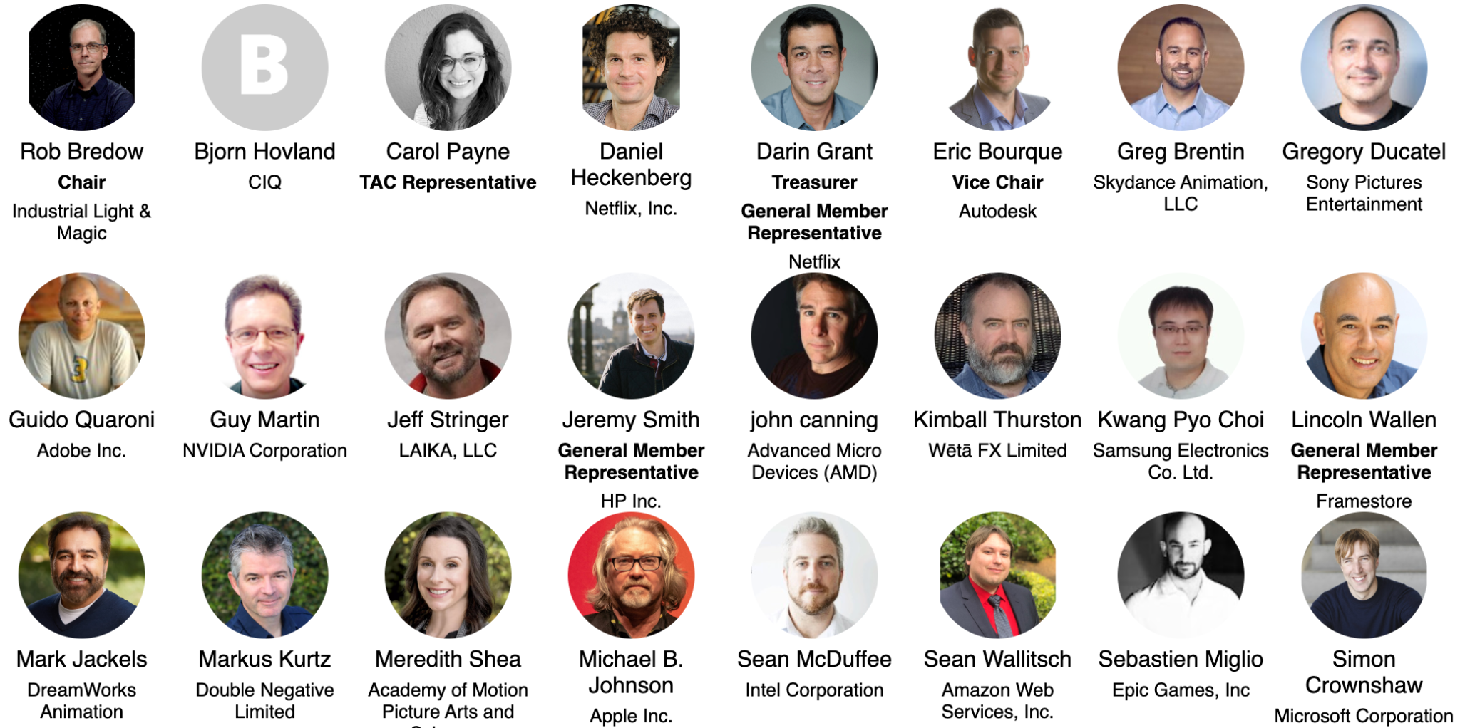

Governing Board Representatives
Notes:
https://jmertic.github.io/committee-gallery/academy-software-foundation-governing-board

Slide 15
Governing Board Representative Characteristics
Knowledgeable / has experience in technology and open source in the media and entertainment industry
Has a point of view on the industry’s future
Is a strategic thinker
Has previous board experience as a plus, but not necessary
Is results-driven
Is an effective communicator
Is respectful of other points of view
Is an influential and empowered decision-maker within their own organization
Is able to create an environment within their organization for developing future ASWF leaders
Is able to develop a Governing Board member pipeline within their own organization
Has demonstrated willingness to contribute, to participate in board/committee activities
Will advocate for the ASWF within their organization
Is committed to make the ASWF as an organization and as a community more diverse

Slide 16
Alternates Policy
Premier and General member companies with appointed representatives on the Governing Board may appoint alternates.
Alternates may attend all Governing Board meetings.
  If the primary representative is present, the alternate may participate in listen-only mode and may not vote or speak.
  Only if the primary representative is unable to attend the meeting, the alternate may speak and vote in lieu of the primary representative.
At Strategy and Leadership Meetings (at which no voting occurs), both primary and alternate representatives may speak (the alternate does not need to participate in listen-only mode)
ACTION: To appoint your representative and your alternate, please file a request at members.aswf.io, and have the representatives create an LF ID.
You can change your representative at any time by making a request at members.aswf.io.

Slide 17
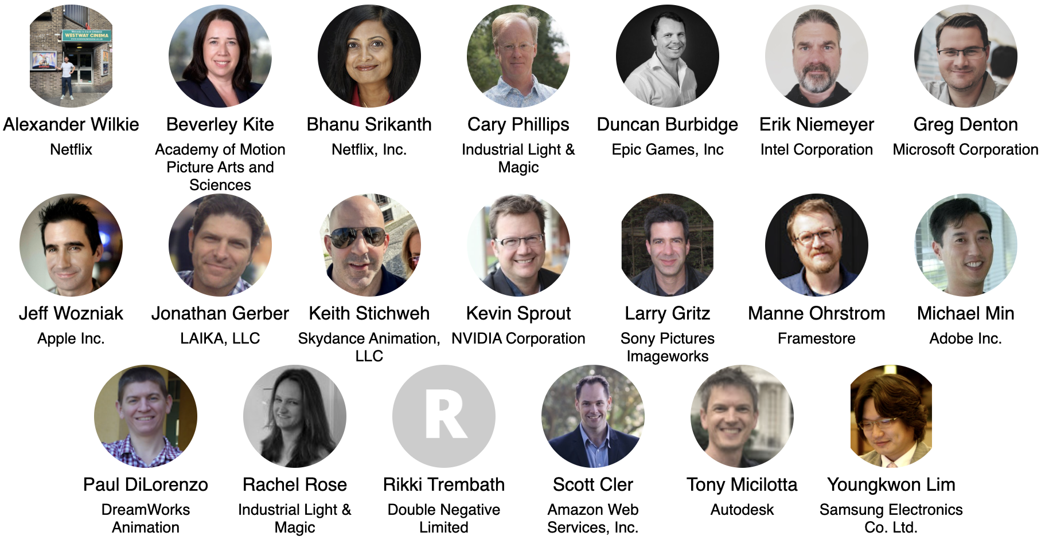

Governing Board Alternates
Notes:
https://jmertic.github.io/committee-gallery/academy-software-foundation-governing-board_slidedeck_alternates

Slide 18
Succession Policy
Maximum term for any Governing Board representative is 4 years.
  Individuals may serve again on the Governing Board after a two year break between terms.
  Individual may serve as an alternate during the two year break.
  There are no lifetime term limits.
Governing Board target goal of rotating 25% of Governing Board representatives on an annual basis.
  If there are less that 25% of new representatives, the Governing Board may request longer tenured representatives to appoint a replacement.

Slide 19
Governing Board Chairperson
Annually in January, the Governing Board will elect a chairperson to serve for the current year.
Duties of the Governing Board Chairperson include:
Oversee the day-to-day operational decisions of the Academy Software Foundation.
Work with the foundation staff to prepare the agenda for Governing Board meetings.
Be a spokesperson for the Academy Software Foundation and the Governing Board, as needed
See Section 3(c) of the Academy Software Foundation Charter for more information about the chairperson role.

Slide 20
Governing Board Treasurer
Annually in January, the Governing Board will elect a treasurer to serve for the current year.
Duties of the Governing Board Treasurer include:
Serve as the chairperson of the Budget Committee
Work with the foundation staff to prepare financial updates and reforecasts to the Budget Committee and Governing Board.
Work with the foundation staff in preparing and leading the approval of the annual budget.
See Section 3(c) of the Academy Software Foundation Charter for more information about the treasurer role.

Slide 21
Governing Board Meetings

Slide 22
Meeting Cadence
The Governing Board has monthly virtual regular meetings, generally on the fourth Thursday of each month.
Format for the meetings alternates between a formal business meeting and strategy session
  At the formal business meetings, voting will often take place.
  For the strategy meetings, the Governing Board will align on a topic to discuss at the previous business meeting.
Additionally, the Governing Board has two hybrid Leadership Meetings sessions per year (at Open Source Forum in February and Open Source Days in August).
  TAC voting members and a representative from each General Member are invited to Strategy Sessions.
In rare and exceptional circumstances (e.g., in an emergency situation), an additional ad hoc special meeting of the Governing Board may be convened.
  To request a special meeting, please email your request to the Foundation Staff and Governing Board Chair, and they will decide whether a special meeting is necessary or the proposed agenda item can be discussed by email or at the next regular meeting.

Slide 23
FY2026
Meeting Schedule
Jan
Feb
Mar
Apr
May
Jun
Jul
Aug
Sep
Oct
Nov
Dec
Jan
Q1
Q2
Q3
Q4
2027
Leadership Meeting
Feb 26
Strategy Meeting
Apr 28
Strategy Meeting
Jun 23
Leadership Meeting
TBD
In person at OSD
Strategy Meeting
Oct 27
Strategy Meeting
Dec 15
Governing Board Meeting
Jan 27
Governing Board Meeting
Mar 24
Governing Board Meeting
May 26
Governing Board Meeting
Jul 28
Governing Board Meeting
Sep 22
Governing Board Meeting
Nov 17
Future Meetings of the Governing Board for 2026 will be held at 1:00 pm US Pacific Time unless noted

Slide 24
How to propose an agenda item
If you would like to propose an agenda item for discussion at a Governing Board meeting, please submit your proposal to the Academy Software Foundation Executive Director & the Governing Board Chair.
Please include in your request:
  A description of the topic
  Board resolution or discussion-only item
  Requested amount of time to discuss the item
For a regular Governing Board meeting, please submit your proposed agenda item at least 10 days prior to the meeting.
For a Strategy Session, please submit your proposed agenda item at least 30 days prior to the meeting.

Slide 25
Proposing an agenda item (continued)
Please be patient. Our board meeting agendas are often very full. If we cannot accommodate your request in the upcoming meeting we may:
  Wait until the following meeting to discuss the topic
  Call a special meeting to discuss your topic, or
  Refer the topic to the appropriate committee or task force of the Governing Board.
We may ask you to provide slides 5 days before the meeting, and slides are subject to change (with your approval) to fit the broader meeting slide deck.

Slide 26
Governing Board Materials
Agendas and Exhibits for Governing Board meetings will be made available one week prior to the scheduled meeting
  The FINAL deck will be made available one day prior to the meeting.
Past meeting materials can be found here.
All meeting materials are confidential and for the view of Governing Board representatives and their alternates ONLY, unless otherwise specified.
  No meeting of the Governing Board is recorded unless the Governing Board provides explicit consent to do so.

Slide 27
Discussion Channels
Relevant Mailing Lists
Governing Board: board@lists.aswf.io
TAC: tac@lists.aswf.io
Budget Committee: budget@lists.aswf.io
Legal Committee: legal@lists.aswf.io
Slack Channel
You can join Academy Software Foundation slack here.
To join the Governing Board slack channel, make a request at members.aswf.io.

Slide 28
Governing Board Committees

Slide 29
Budget Committee
The Budget Committee is lead by the Governing Board Treasurer and collaborates with the Academy Software Foundation staff to develop and review the Academy Software Foundation budget.
Any Governing Board representative may join ( not alternates )
Meets generally monthly on the Monday of the week before the Governing Board meeting
ACTION: If you want to participate in the Budget Committee, make a request at members.aswf.io.

Slide 30
Legal Committee
The Legal Committee makes recommendations to the Governing Board regarding license exception requests from Academy Software Foundation projects and other questions submitted to the Legal Committee by the Governing Board.
The Legal Committee does not represent Academy Software Foundation and does not have an attorney-client relationship with Academy Software Foundation.
Meets on an as needed basis.
Governing Boards may attend only if accompanied by their legal counsel.

Slide 31
Policies and Other Resources

Slide 32
Important Academy Software Foundation Policies and Resources
Academy Software Foundation Charter
Linux Foundation Antitrust Policy
Foundation GitHub repository with many other public facing policies and materials including…
  Elections Process
  Academy Software Foundation hosted project charters, which define each project’s intellectual property and licensing policies.
ASWF Landscape

Slide 33
LFX Organization Dashboard
LFX Organization Dashboard provides access to key membership materials, including…
  Member contacts, which you can change at any time ( look under ‘Users’ > and then under the ‘Key People’ tab )
  Membership details ( look under ‘Membership’ > ‘Academy Software Foundation’ ), including…
    Membership Overview Deck and High Level Overview Deck ( look under the ‘Resources’ tab )
    Your fully executed membership agreement ( look under the ‘Membership’ tab )
    Details on how to leverage membership benefits ( look under the ‘Benefits’ tab )
    Insights on contributors from your organization ( look under the ‘Project Contributors’ tab )
ACTION: Request access to LFX Organizational Dashboard here.

Slide 34
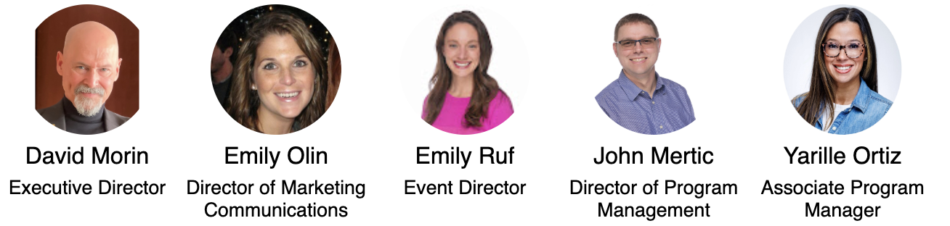
Foundation Staff
Contact the staff at members.aswf.io
Notes:
https://jmertic.github.io/committee-gallery/academy-software-foundation-staff_slidedeck_all

Slide 35
Who’s Who in the Academy Software Foundation
Academy Software Foundation Members
Staff: Academy Software Foundation Staff, Linux Foundation Leadership
Governing Board Members
Technical Advisory Council Members
Academy Software Foundation Project and Working Group Leads

Slide 36
Thank you!
If you have any questions, feel free to contact the staff at members.aswf.io.

